Slide 1
Biometric, Visual recognition, and Forensic Applications.

Slide 2

Pattern Recognition (CSE 467)
Presented to
Badhan Chandra Das
Lecturer
Department of CSE
Bangladesh university of Business and Technology (BUBT)
Presented by
Nusrat Jahan Anka – 17183103008
Syeda Nowshin Ibnat – 17183103020
Rakibul Ahasan – 17183103022
Mohammad Sabbir Ahmed – 17183103004
Sheikh Abu Hanif – 17183103043
Intake: 39(2), Dept. of CSE, BUBT
Date: 30 - 06 - 2022

Slide 3
Contents
Introduction
Conclusion
I
C
Overview
Applications
O
A

Slide 4
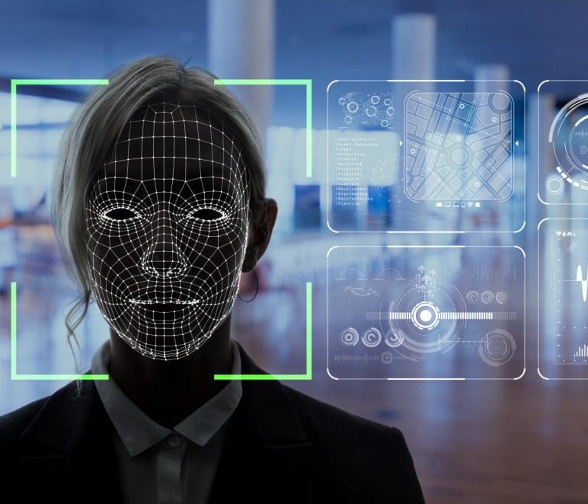
Introduction
Biometrics “bio” (life) and “metrics” (to measure).
Visual recognition context of machine vision.
Forensic “forensis” (before the forum)

Slide 5
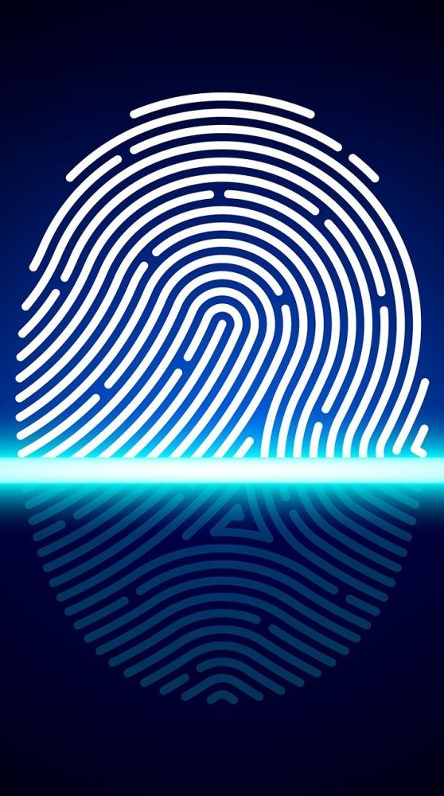
Biometric
Unique physical or behavioral human characteristics.
Method of digitally identify a person.

Slide 6
Law enforcement
01
Banking
05
Applications
02
Home Assistant
Mobile Access
04
03
Blood Banks

Slide 7

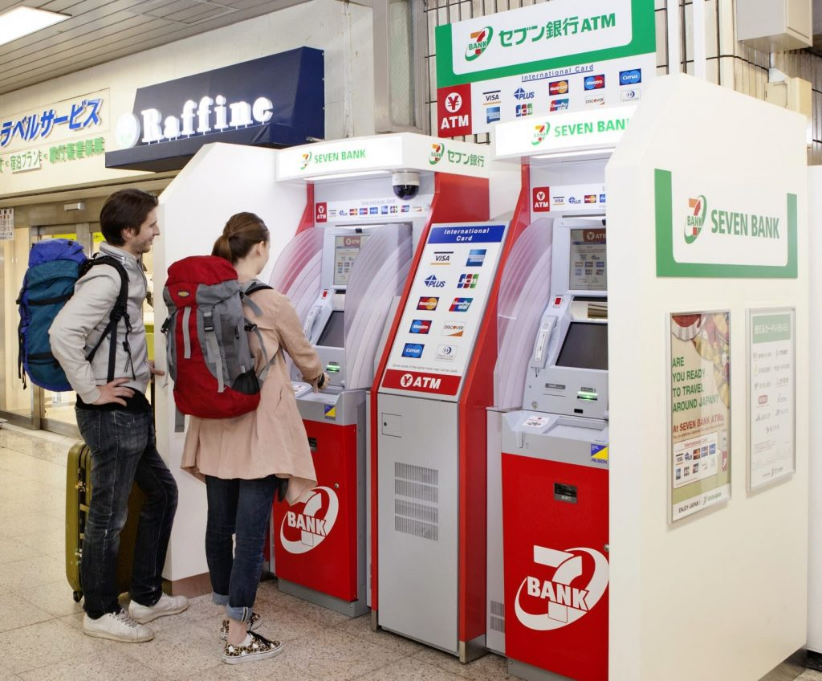
Home Assistants
We all are familiar with Google Assistant, Alexa etc. and they are already using voice recognition as a biometric identifier.
Banking
Seven Bank in Japan is rolling out a trial of Facial Recognition at ATMs.

Slide 8
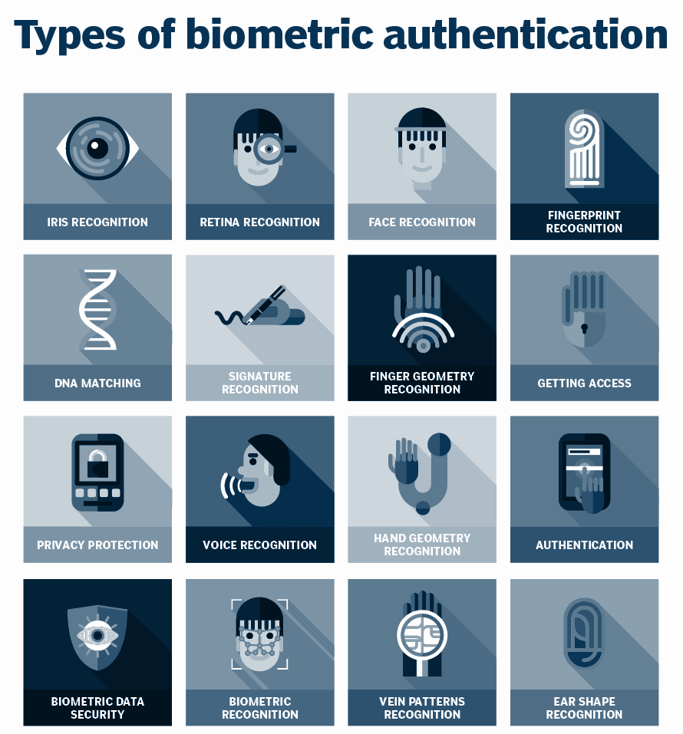

Slide 9
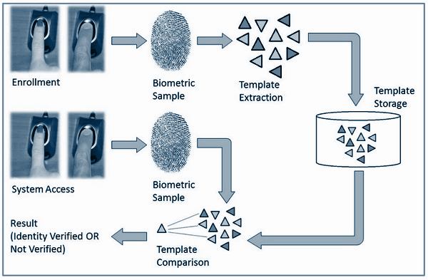
Fingerprint Recognition

Slide 10
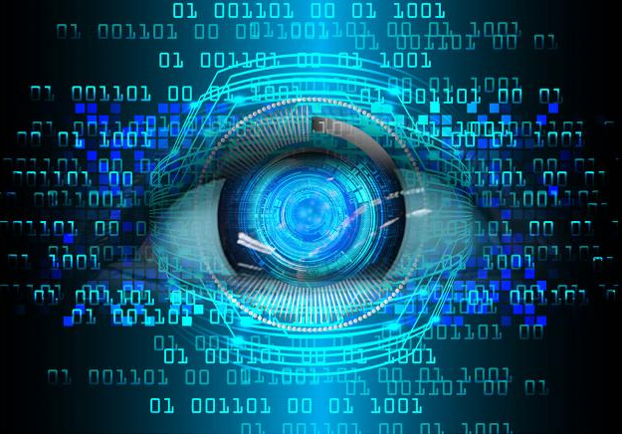
Visual recognition
Visual recognition refers to the ability to identify the objects in view based on visual input.
It’s Processing of basic object components, such as color, depth, and form.

Slide 11
Applications
Facial Recognition
Self-Driving Cars
People Counting
Industrial Quality Check

Slide 12

Facial Recognition
For example , Google Photos, which automatically separates all pictures based on the person in the picture. Many components are involved in facial recognition, such as face, nose, mouth, and eyebrow.

Slide 13
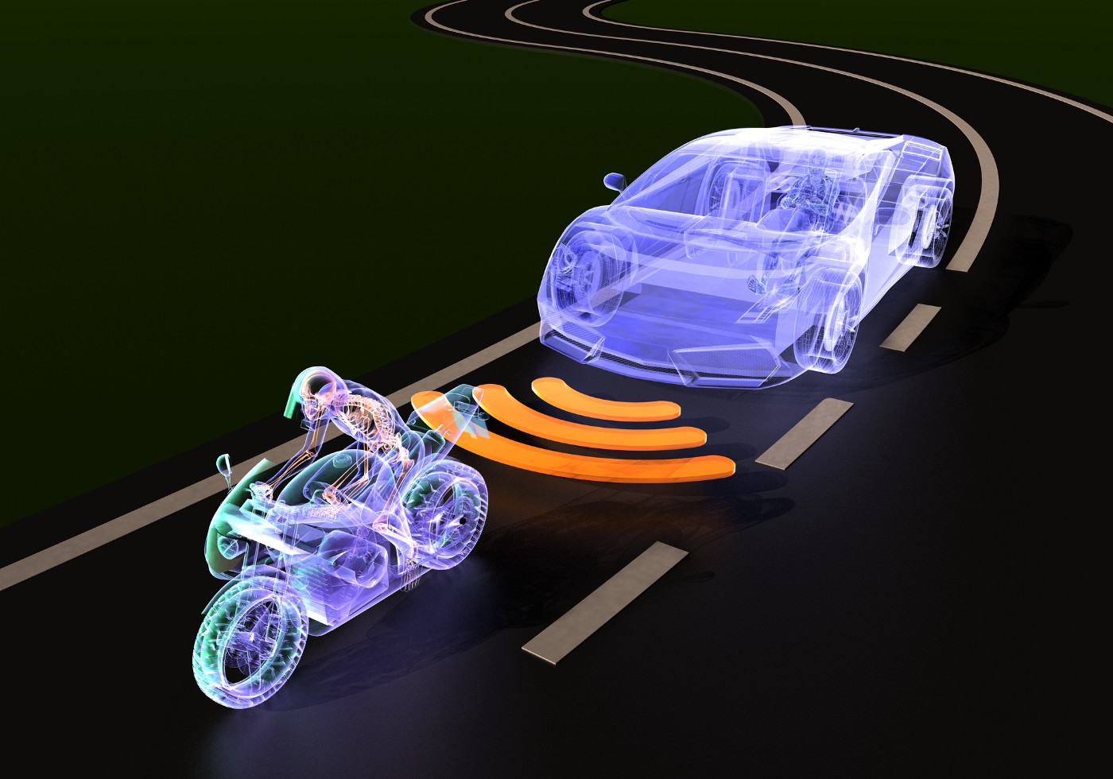
Self-Driving Cars
Visual recognition Identify appropriate obstacles. Once ever the image sensor detects any sign of living thing in its way, it automatically stops

Slide 14
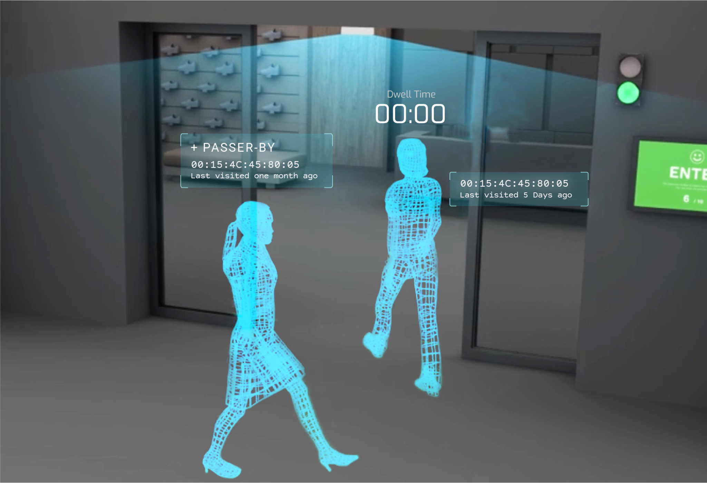
People Counting
Visual recognition can be used for people counting, and it is used for analyzing store performance or crowd figures during festivals.

Slide 15
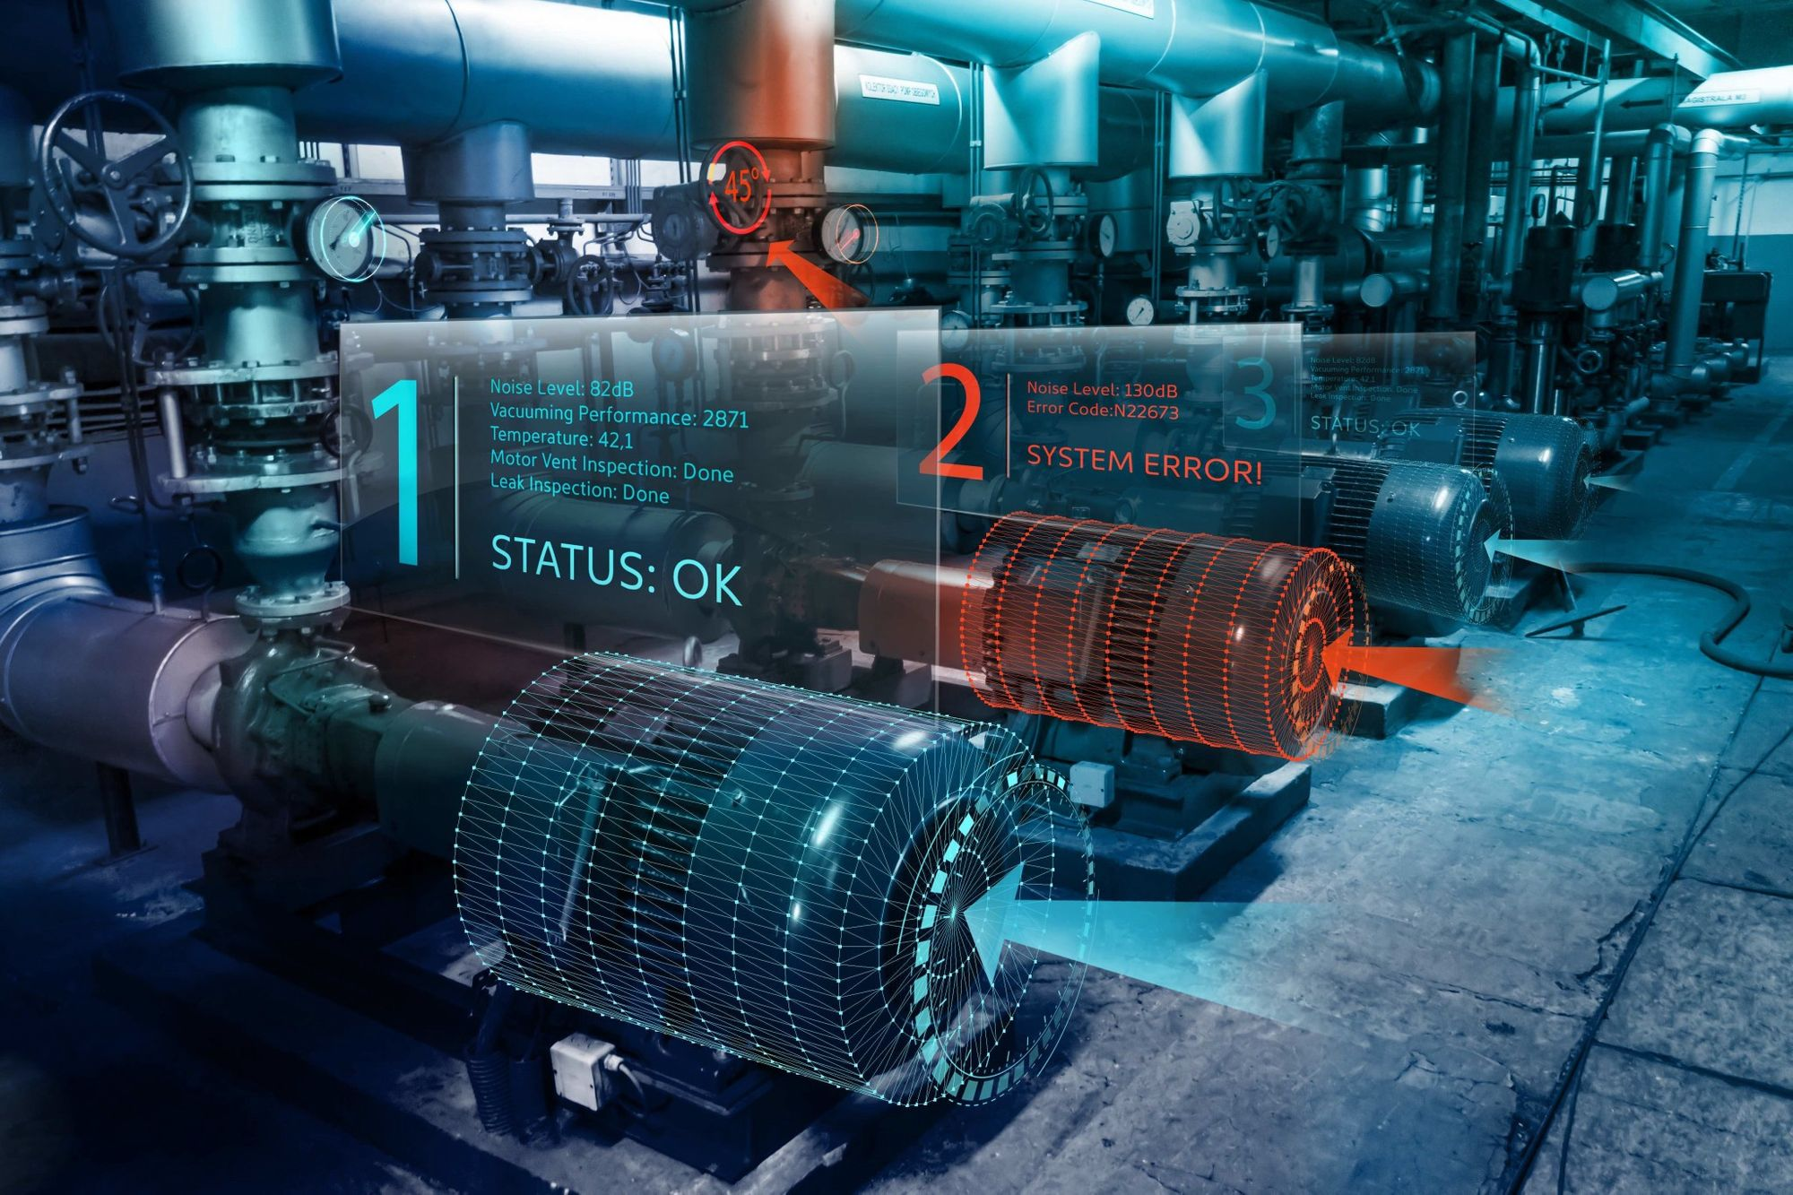
Industrial Quality Check
Visual recognition is also used in the industrial process to identify products. Like inventory management, machining, quality management, packaging, sorting, etc.

Slide 16
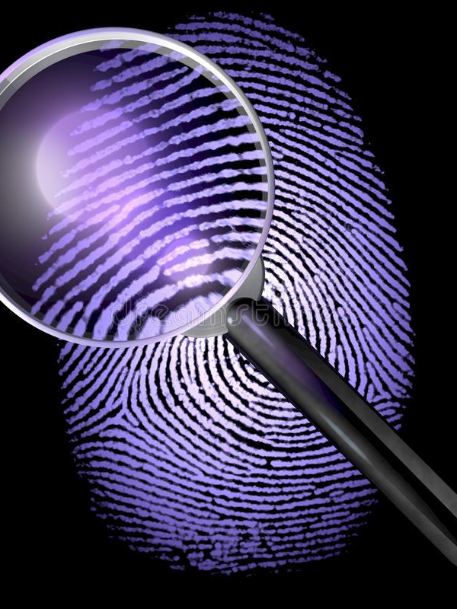
Forensic
Forensic is defined as using technology or science to prove something legally.
Use of science or technology in the investigation and establishment

Slide 17
Applications
It involves procedures of detail internal and external examination of the body including detailed autopsy.
Forensic Document Examination
Forensic Photography
It deals with the comparison of the unknown document sample with the requested specimens to establish the identity of an author.
It deals with the application of photographic techniques to capture the scene of the crime as a record.
Forensic Medicine

Slide 18
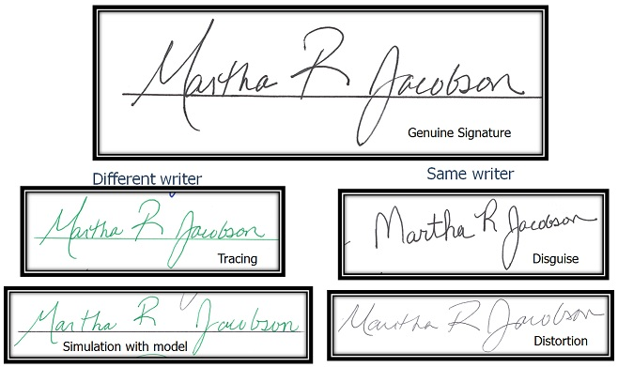
Forensic Document Examination

Slide 19
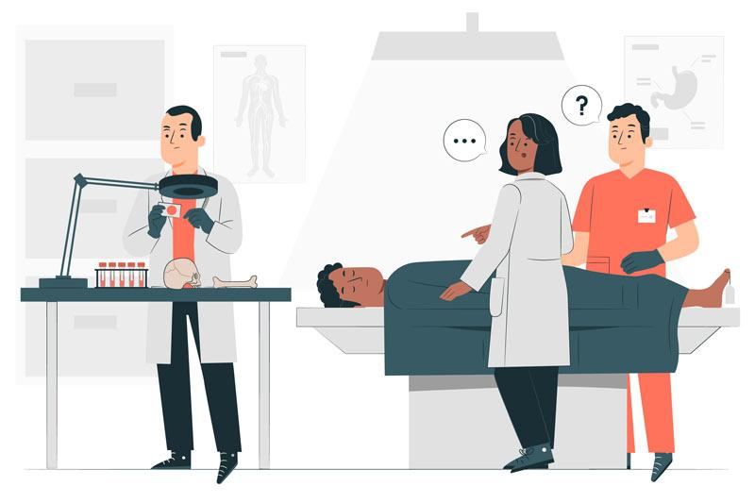
Forensic Medicine

Slide 20
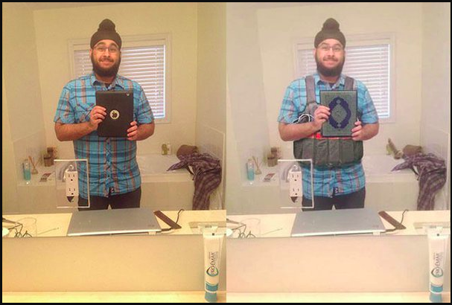
Photo Forensic
Original Image
Fake Image

Slide 21

Disadvantages
Biometric
False positives
Scanner compatibility
Privacy issues
Visual Recognition
low resolution
poor lighting
complex backgrounds
Forensic
Expensive Equipment
Time consuming
Evidence manipulation

Slide 22
Conclusion
Now-a-days biometric, visual recognition & forensic are trendy words. All these technologies are mostly used for the security concern & own safety.

Slide 23
Reference
History of Biometrics
What Is Image Recognition
The Top 9 Common Uses of Biometrics in Everyday Life
Efficient Visual Recognition | SpringerLink
8 Uses Cases Of Image Recognition That We See In Our Daily
What is Forensic Science? | Applications & Sub-Disciplines
Fraudulent Activities Regarding Paris Attack

Slide 24
Thank You!

